Slide 1

Ford furgasin
Kevin Monama | Data Analyst
Engagement Report & Dashboard 2026

Slide 2
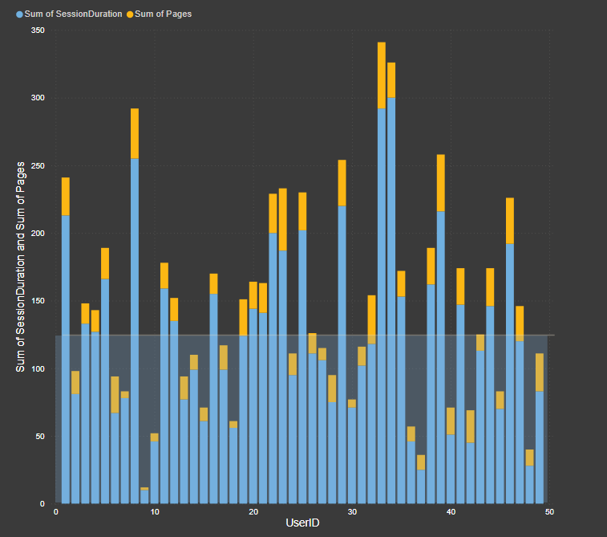
FORD FURGASIN – ENGAGEMENT RETENTION & USER ANALYTICS INTELLIGENCE REPORT 2025
This Business Intelligence Report Investigates User:
engagement behavior
retention trends
conversion performance
and platform activity
metrics for
Ford Furgasin
The analysis transforms dashboard metrics into executive-level storytelling to uncover operational weaknesses, growth opportunities, and strategic recommendations.
The report focuses on:
Daily Active Users (DAU)
Monthly Active Users (MAU)
Click Through Rate (CTR)
Conversion Rate
Average Daily Users
Average Monthly Users
Session Duration
Page Retention
Engagement Forecasting

Slide 3
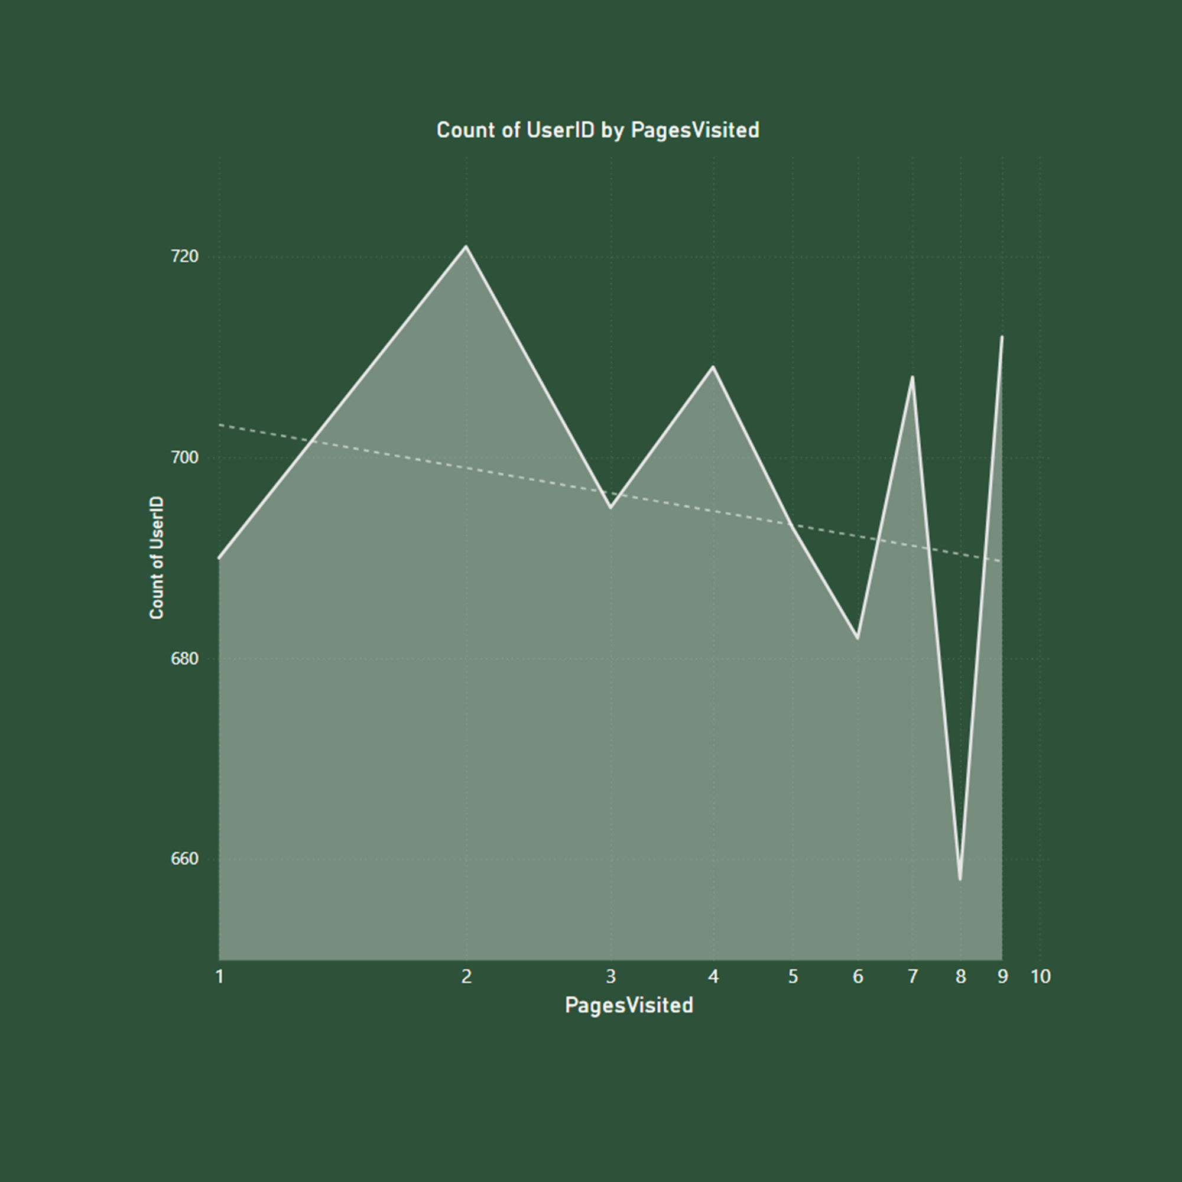
EXECUTIVE SUMMARY
Ford Furgasin is experiencing a period of measurable user growth combined with unstable engagement quality.
The analytics dashboards reveal a platform attracting increasing traffic, but behavioral signals suggest declining interaction depth and inconsistent user retention.

Slide 4
The business currently demonstrates:
Strong DAU expansion
Declining average session duration
Weak engagement consistency
Volatile user retention behavior
Risk of long-term churn escalation
The core challenge is not visibility or acquisition, but maintaining meaningful interaction quality after users enter the platform.
This analysis evaluates how engagement metrics influence long-term platform sustainability and profitability.

Slide 5
BUSINESS PROBLEM STATEMENT
Ford Furgasin faces several strategic business problems impacting engagement retention and conversion efficiency.
Problem 1: Declining Session Quality Although users continue returning to the platform, average engagement duration is decreasing. Users are spending less time consuming content or interacting deeply with platform features.
Problem 2: Weak Retention Stability Retention patterns fluctuate heavily across different engagement periods, indicating users are not consistently forming long-term behavioral habits.
Problem 3: Navigation Drop-Off Page retention metrics reveal declining engagement as users navigate deeper into the ecosystem. This suggests content discovery inefficiencies or weak user journey optimization.
Problem 4: Conversion Funnel Leakage Traffic acquisition may be outperforming conversion efficiency. Users enter the platform but do not consistently complete target actions.
Problem 5: Forecasted Engagement Risk Trend forecasting reveals possible future engagement decline if personalization and retention systems are not strengthened.

Slide 6
Key KPIs Analyzed
Daily Active Users (DAU) Measures how many users actively engage with the platform daily.
Monthly Active Users (MAU) Tracks the scale and sustainability of monthly engagement.
Average Daily Users Measures consistency in daily interaction behavior.
Average Monthly Users Measures long-term engagement ecosystem health.
Click Through Rate (CTR) Evaluates how effectively users interact with content and calls-to-action.
Conversion Rate Measures successful completion of business objectives including sign-ups, purchases, or interactions.
Session Duration Tracks engagement depth and user attention quality.
Page Retention Measures how successfully users continue navigating through the platform.
Engagement Forecasting Projects future engagement scenarios based on current behavioral patterns.

Slide 7
DATA STORYTELLING & DASHBOARD INTERPRETATION
The engagement dashboards reveal a platform growing in visibility but struggling with behavioral depth.
This indicates:
Strong acquisition campaigns
Improved market visibility
Increased user awareness
Effective traffic generation
However, average session duration declined during the same period from roughly 920 minutes toward 845 minutes.
The first dashboard focusing on DAU and session duration demonstrates a critical behavioral contradiction. Daily Active Users increased significantly between January and February, moving from approximately 2,200 active users toward nearly 3,900 users.

Slide 8
This behavioral contradiction suggests:
Stable Scenario:
Engagement stabilizes around 30 points. Growth remains operationally sustainable but strategically stagnant.
Users are entering the platform but not staying engaged
Content relevance may be declining
User experience friction could exist
Personalization systems may be weak
Platform value perception may not be increasing with traffic
The forecasting model further highlights three possible business futures.
This suggests:
Campaign-driven spikes
Behavioral inconsistency
Weak retention loops
User fatigue after acquisition
Limited habit formation
Collectively, the dashboards reveal that Ford Furgasin has successfully improved acquisition visibility but has not yet fully optimized behavioral retention systems.
Optimistic Growth Scenario:
Engagement rises toward 45+ average engagement points. This scenario would likely emerge if Ford Furgasin improves personalization, recommendation systems, and behavioral targeting.

Slide 9
Engagement Retention Analysis
Retention is one of the most important indicators of digital platform health because it determines whether users derive sustainable value from the ecosystem
Average User Behavior:
Average daily users fluctuate significantly, suggesting behavioral instability rather than habitual engagement patterns.
Conversion Efficiency:
The conversion funnel may contain friction points causing users to abandon actions before completion.
Page Retention:
Users appear increasingly likely to disengage as they progress through navigation layers. This highlights the importance of simplifying information architecture and improving recommendation systems.
Session Duration:
Session duration decline is one of the strongest warning indicators within the analysis because it reflects weakening interaction quality.
.
CTR Performance: CTR performance likely reflects strong curiosity-based acquisition but weaker post-click satisfaction. Users appear willing to engage initially but may not consistently find meaningful value afterward.
DAU vs MAU Relationship: The DAU and MAU relationship suggests healthy platform exposure but inconsistent recurring engagement behavior. Sustainable platforms typically maintain strong ratios between active daily users and active monthly users.

Slide 10
Strategic Insights
Insight 1: Acquisition Is Outperforming Retention The company successfully attracts users but struggles maintaining behavioral depth.
Insight 2: Session Quality Is Declining Lower session duration indicates weaker emotional connection or platform utility.
Insight 3: Navigation Complexity Reduces Engagement Users disengage more frequently when progressing deeper into content pathways.
Insight 4: Forecasting Reveals Churn Risk If engagement quality continues weakening, future retention rates may decline significantly.
Insight 5: Behavioral Loyalty Has Not Fully Matured Engagement volatility suggests users are not yet forming platform dependency or routine usage behavior.

Slide 11
Recommendations
Improve Personalization Systems Deploy AI-driven recommendation systems tailored to user behavior patterns.
Simplify Navigation Architecture Reduce friction by streamlining user journeys and improving content accessibility.
Introduce Behavioral Engagement Loops Implement rewards, streak systems, achievement tracking, and gamification strategies.
Strengthen Conversion Funnel Monitoring Track behavioral drop-off points more aggressively through funnel analytics.
Enhance Onboarding Experience Educate users faster about platform value during first-time interaction.
Introduce Predictive Retention Analytics Use forecasting models to identify users likely to churn before disengagement occurs.
Optimize CTR Campaigns Focus on attracting users with higher behavioral quality instead of purely maximizing clicks.
Deploy Cohort Analysis Analyze engagement by user cohorts to identify long-term retention patterns.
Expand Executive Dashboards Provide leadership teams with real-time behavioral intelligence monitoring.
Conduct A/B Testing Continuously test page structures, CTA positioning, layouts, onboarding, and recommendation systems.

Slide 12
Business Impact
If Ford Furgasin successfully improves retention quality and engagement depth, the company could achieve:
Increased customer lifetime value
Lower churn rates
Improved monetization performance
Higher conversion efficiency
Better advertising returns
Stronger customer loyalty
Improved user satisfaction
Greater long-term scalability
Stronger investor confidence
Retention optimization has direct financial implications because retained users generate substantially more long-term value than short-term acquisition spikes.

Slide 13
Caveats & Analytical Limitations
Several analytical limitations should be acknowledged.
The dashboards represent a limited observation period.
Forecasting assumptions may shift with market conditions.
Seasonal trends may influence engagement metrics.
External campaigns may temporarily distort DAU activity.
Demographic segmentation data was unavailable.
Device-level analytics were not integrated.
Revenue attribution data was limited.
Future analysis should include:
Cohort retention analysis
Device segmentation
Geographic segmentation
Sentiment analysis
Revenue contribution modelling
Funnel attribution tracking

Slide 14
Conclusion
Ford Furgasin demonstrates strong acquisition capability supported by increasing Daily Active Users and rising platform visibility. However, the analytics reveal that long-term engagement sustainability depends heavily on improving retention quality, personalization systems, and behavioral consistency.
The company has reached a strategic phase where growth alone is no longer sufficient. Sustainable success will depend on increasing interaction depth, emotional engagement, and platform loyalty.
By improving user experience architecture, predictive analytics, onboarding systems, and behavioral personalization, Ford Furgasin can transform traffic growth into long-term ecosystem expansion.
This project demonstrates the importance of business intelligence in converting engagement metrics into strategic decision-making frameworks.

